Slide 1

Fairbnb: A San Diego Airbnb Price Fairness Estimator
Hunter Blum
Kyle Esteban Dalope
Nicholas Lee
University of San Diego
Master’s Program
Applied Data Science
Summer 2023

Slide 2
Table of Contents
Introduction to the Problem and Background
Problem Statement
Pipeline Overview
EDA
Missing Value Handling
Feature Engineering
Modeling
Results: Evaluation, Discussion, Notable Findings, and Interpretation
Conclusion and Next Steps

Slide 3

Introduction and Background
2%
6.1%
Short-term rental services (e.g. Airbnb)
Pricing is subject to change - set by independent listers
Increased cost-of-living
Renters are more interested in fair housing prices
2022 Inflation Rate
2023 Inflation Rate
Notes:
U.S. Census Inflation Rate
Stock photo from: https://www.pexels.com/photo/person-holding-white-iphone-5-c-5077042/

Slide 4
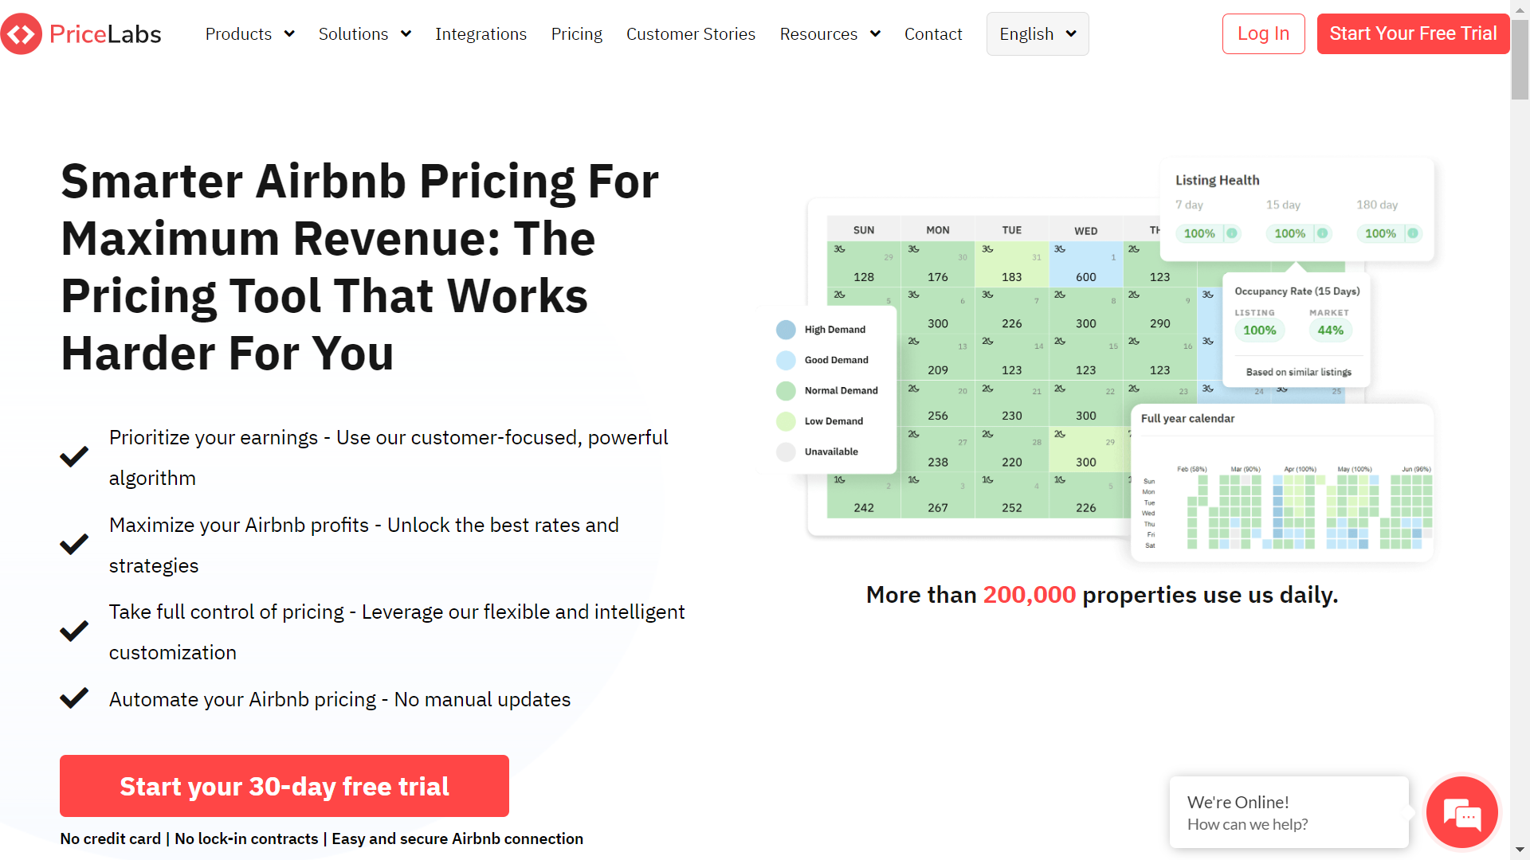
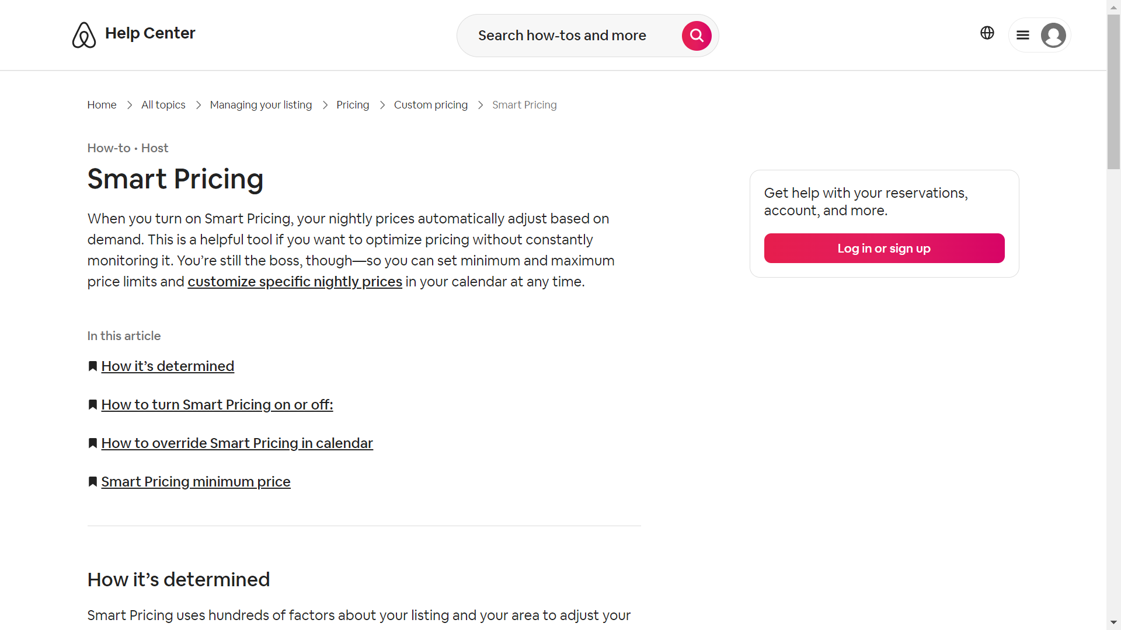
Problem Statement
Listers’ ML Tools:
PriceLabs
Airbnb Smart Pricing
…and more
Maximize profitability
No transparency
Notes:
Listers have ML tools - many tools such as …
Tools are designed to remain competitive and maximize profitability/revenue
Lee (2016) - some listers set the price equal to the value of their properties, others set it to compete with hotel pricing
Renters do not have as many ML tools, if any
No means of assessing prices
All tools lack transparency, not indicating which features/aspects of the property/lister justify the set price
PriceLabs photo screenshot from: https://hello.pricelabs.co/airbnb-pricing-tool/?utm_source=google&utm_medium=cpc&utm_campaign=channel_airbnb_us&utm_term=airbnb+pricing+tool&utm_content=skag_pm_airbnb_pricing_tool_bof&gclid=Cj0KCQjwz8emBhDrARIsANNJjS62j6lPA1GpqvA16SAe8u2jYGh5YwqAXjx6H0IOeQWKZbSfwHevKZMaAgUBEALw_wcB
Airbnb Smart Pricing Screenshot from: https://www.airbnb.com/help/article/1168

Slide 5
End-to-End Pipeline
EDA
Feature Engineering
Preprocessing
Model Training
Evaluation and Deployment
Descriptive Statistics
Univariate and bivariate analysis
New feature creation
Feature removal
Missing values resolution
Numerical feature standardization
Categorical feature encoding
Data set partitioning
Hyperparameter tuning
Cross-Validation
Test set performance metric(s) evaluation
Optimal model selection
App development

Slide 6
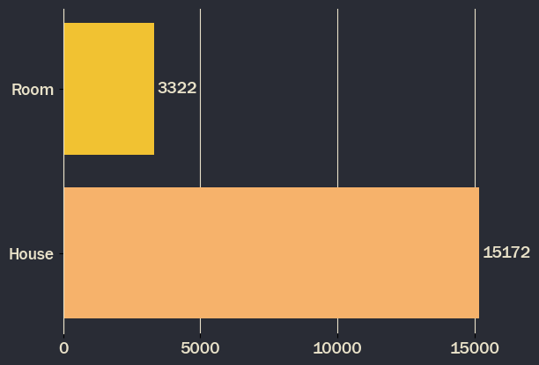
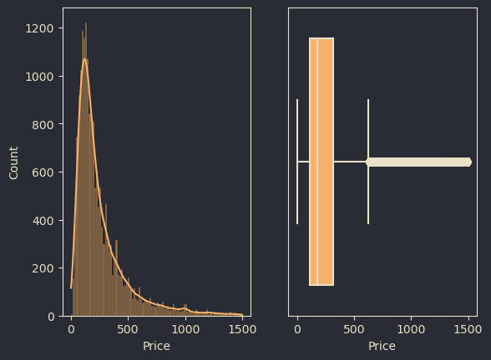
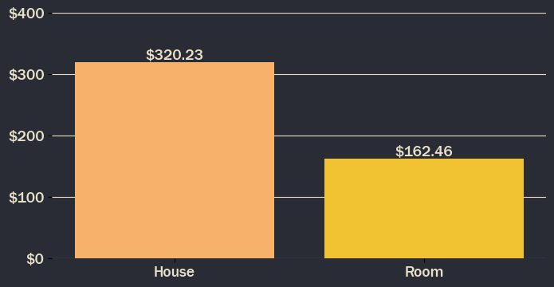
Exploratory Data Analysis
Data Description
Count by Property Type
Distribution of Price
Note: 386 observations had a price above $1,500
Average Rate by Property Type
18,627
74
$320.23
Unique Listings
Initial Features
Average Home Price per Night
Notes:
4 CSV files representing quarterly scrape data from Airbnb, provided by Inside Airbnb
74 initial features
Also, used data from the U.S. Census Bureau to acquire information on zip codes and their respective median income information
There were many types of listings; however, all the listings grouped into two general categories: entire houses or single rooms
The average price is heavily influenced by outliers at the higher end of the price spectrum

Slide 7
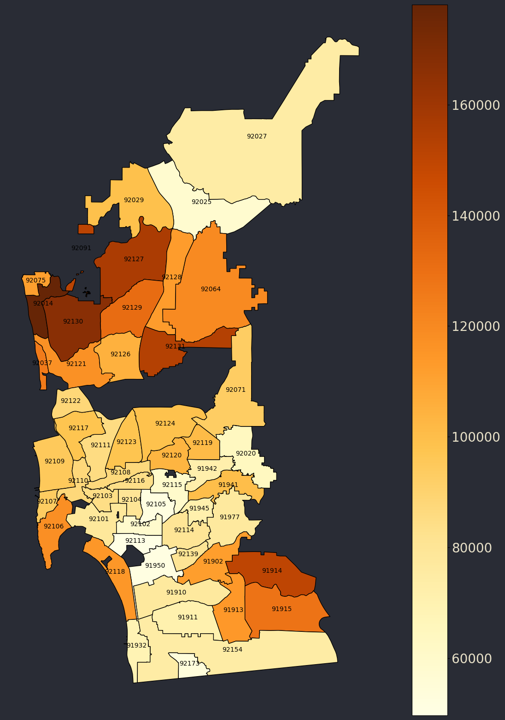
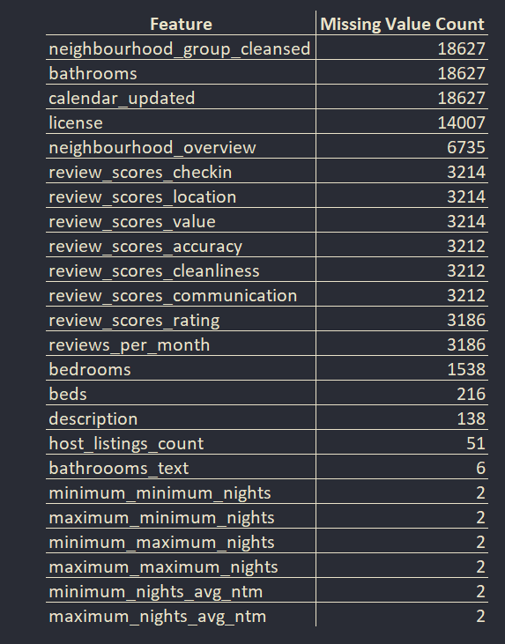
Feature Engineering & Preprocessing
Missing Values Evaluation
Median Income by Zip Code
Handling missing and null values
Feature creation
Zip code
Median income
Notes:
Missing values evaluation - 3 columns, neighbourhood group cleansed, bathrooms and calendar updated, are missing values for every single row. While, neighbourhood group cleansed and calendar updated may be dropped, as their information is not especially key to determining price, the number of bathrooms is key. Bathrooms text is a text version of the the numerical bathrooms column. Bathrooms text can be used to fill the missing values for bathrooms.
Feature creations - Zip code was created with the longitude and latitude coordinates, while the median income was created with the census data for income of the San Diego area.

Slide 8
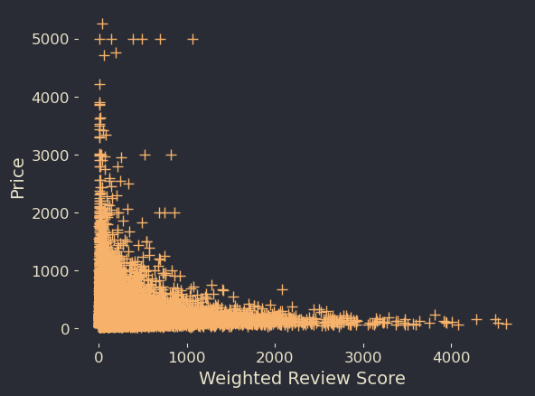
Feature Engineering
Weighted Review Score:
Review scores rating and number of reviews multiplied Sentiment:
Probability that host supplied text is positive
Notes:
Sentiment analysis on the text-based variables was utilized to capture emotional tone of the how the hosts titles the property and the description of the property and neighborhood for each of the Airbnb listings. The weighted review score was generated by multiplying the review_scores_rating, a combination of various review score categories such as host responsiveness, cleanliness and more, by the number of reviews provided a higher correlation to prices.

Slide 9
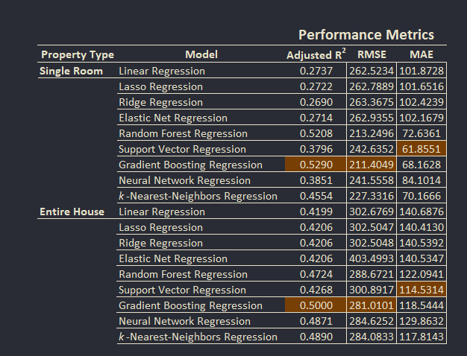
Modeling
2 separate models
Baseline modeling
Hyperparameter Tuning with Cross Validation
Performance Metrics: adjusted-R², RMSE, MAE
Notes:
Voltes-Dorta, A., & Sánchez-Medina, A. (2020) - multiple models by property types allowed for better price predictions than one general model for all property types

Slide 10
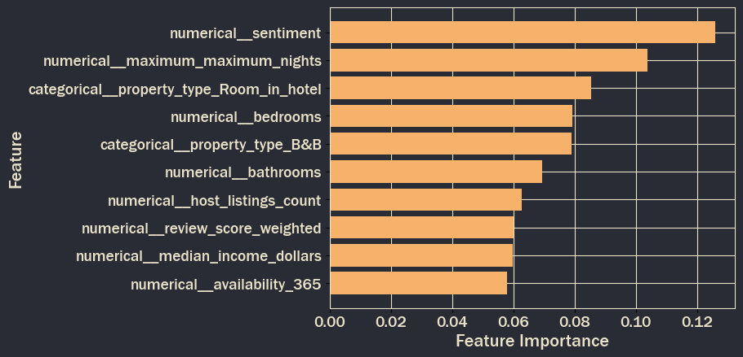
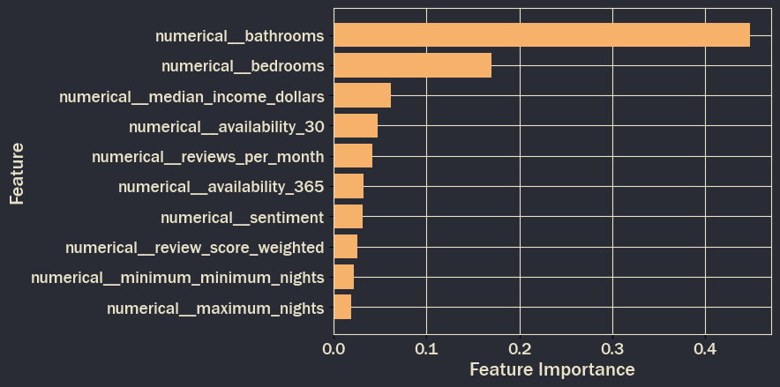
Model Evaluation
Room Model Feature Importance
House Model Feature Importance
Optimal model: gradient boosting regression
Feature importance
Single-room vs House based models
Notes:
Feature importance based on each property type, room and house. These figures represent the feature importance scores based on the optimal model (gradient boosting).

Slide 11


Notable Findings and Interpretation
Model performance based on property type
Transparency to renters and identify key determinants of Airbnb prices
Notes:
Model performance - the performance metrics indicates that the model’s predictions deviated further from the expected listing prices if the property is an entire house than the single-room. Based on the property type, this allowed for a more specific approach in predictability as it can attributed to a variety of factors such as inadequate representation in the data, outliers, or bias price settings in the market.
Transparency - identifying the optimal model as the gradient boosting regression for both property types, supported the initial hypothesis that machine learning models can be utilized to help renters assess both fair rental prices and key determines of prices when searching for Airbnb listings.

Slide 12

Discussion
Comparison to prior research and studies
Enhancing the predictability of the models
Limitations
(Redirect Notice, 2023)
Notes:
When comparing this study to previous research, it was found that the random forest models yielded the lowest error when analyzing Airbnb prices (Lektoroov et al., 2023 and Dhillon et al., 2021) as this study concluded the gradient boosting regression model was comparable to the previous research with differing performance metrics and further optimization.
The engineering approach of feature creation and optimization, after evaluation it was found to enhance the model performances. Important features include the sentiment-based feature, number of bedrooms and bathrooms, weighted review scores, and the median income.
Within this study, the team acknowledges that the data was limited and included a vast array of features initially. Importantly, this study is also limited to the San Diego region of California and unlikely to be generalized to other locations.

Slide 13
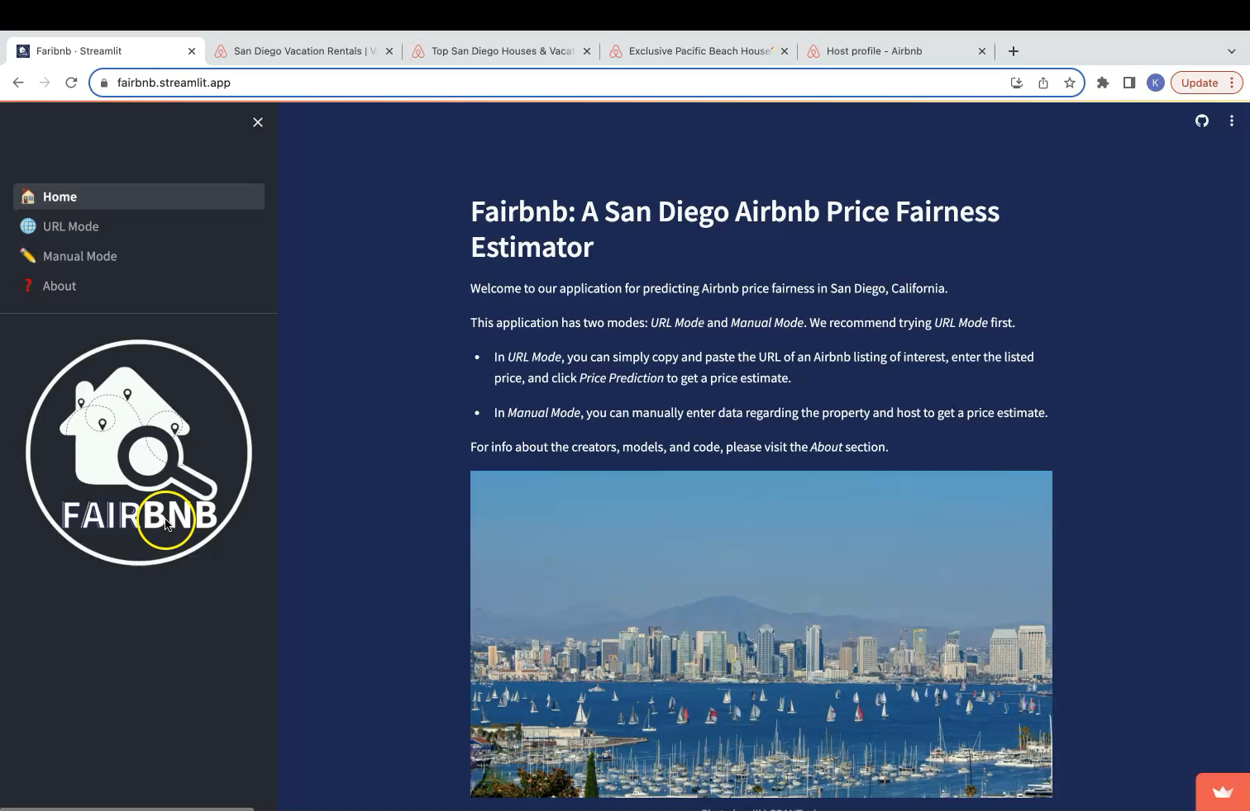
Final Application
Deployed application: Fairbnb: A San Diego Airbnb Price Fairness Estimator
Notes:
Discussing the demo
In order:
Welcome to our Fairbnb application. The deployed application begins with the home page and summarizes the purpose of this website and the two modes available; which are the URL mode and the Manual mode.
We’ll first begin with the URL mode. So, the user will be able to obtain the URL from Airbnb’s listings. For example, if you were searching for a listing in the San Diego area of an entire house for the weekend and found the particular listing of interest. You can copy and paste the Airbnb URL into the application and list the nightly price.
Next, if the URL link is not available or a listing is not set up. The user can manually enter the necessary information to get the price. To note, the count of the “host listings” can be found on the host’s profile page under “[Host name] listings”.
Lastly, the About page provided a summary of the team and provide the transparency of the how the predicted prices were calculated and the important features to consider.

Slide 14
Conclusion and Next Steps
Key Takeaways:
Reasonable Price Predictions
Determinants of Price Transparency
Explainable Models Perform Just as Well
Future Goals:
Further optimization
Application adjustments
Expand geographical usage
Notes:
Prices predicted are reasonable, given error metric value contains both the difference between the fair and listed price and the actual prediction error
Explaining to customers the top contributors to price is possible with the right ML algorithm
Explainable models perform just as well as Unexplainable/Blackbox models
Further optimize the model and application for better performance
Add a webscraping component to acquire data in manual mode, rather than relying on mean values of similar listings
Add new regions so that the application can be used outside of San Diego

Slide 15
References
Dhillon, J., Eluri, N. P., Kaur, D., Chhipa, A., Gadupudi, A., Eravi, R. C., & Pirouz, M. (2021, January). Analysis of Airbnb Prices using Machine Learning Techniques. In 2021 IEEE 11th Annual Computing and Communication Workshop and Conference (CCWC) (pp. 0297–0303). IEEE.
Lee, D. (2016). How Airbnb short-term rentals exacerbate Los Angeles's affordable housing crisis: Analysis and policy recommendations. Harv. L. & Pol'y Rev., 10, 229. https://heinonline.org/HOL/LandingPage?handle=hein.journals/harlpolrv10&div=13&id=&page=
Lektorov, A., Abdelfattah, E., & Joshi, S. (2023, March). Airbnb Rental Price Prediction Using Machine Learning Models. In 2023 IEEE 13th Annual Computing and Communication Workshop and Conference (CCWC) (pp. 0339–0344). IEEE.
Redirect Notice. (2023). Google.com. https://www.google.com/url?sa=i&url=https%3A%2F%2Fwww.freepik.com%2Ffree-photos-vectors%2Fdiscussion&psig=AOvVaw2w9ZxBx_3z8yZQ_NqlzmqF&ust=1691806867004000&source=images&cd=vfe&opi=89978449&ved=0CBAQjRxqFwoTCICii_PF04ADFQAAAAAdAAAAABAD
U.S. Census Bureau. (2023). S1901: Income in the past 12 months (In 2021 inflation-adjusted dollars). https://data.census.gov/
Voltes-Dorta, A., & Sánchez-Medina, A. (2020). Drivers of Airbnb prices according to property/room type, season and location: A regression approach. Journal of Hospitality and Tourism Management, 45, 266–275. https://doi.org/10.1016/j.jhtm.2020.08.015
‌

